Slide 1


Slide 2
Automated testing

Slide 3
Playwright

Slide 4
Options
Record
Write (TypeScript or JavaScript)
AI
Agents
MCP server
CLI (Command Line Interface)

Slide 5
Agenda
Start | End | Topic
9:00 | 9:30 | Intro (Speakers + Audience)
09:30 | 10:15 | Overview of DevOps
10:15 | 11:00 | Pre-requisites + Lab Intros
11:00 | 11:15 | Break
11:15 | 13:00 | Labs
13:00 | 14:00 | Lunch
14:00 | 14:45 | Testing Session
14:45 | 16:30 | Labs (Including testing)
16:30 | 17:00 | Q&A + Wrap Up

Slide 6
Intro to DevOps
DevOps
Plan
Develop
Build
Test
Release
Operate

Slide 7

Early days of Power Platform DevOps

Slide 8

Current Expectations of Power Platform DevOps

Slide 9
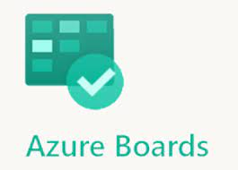
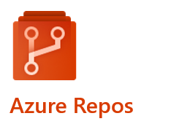
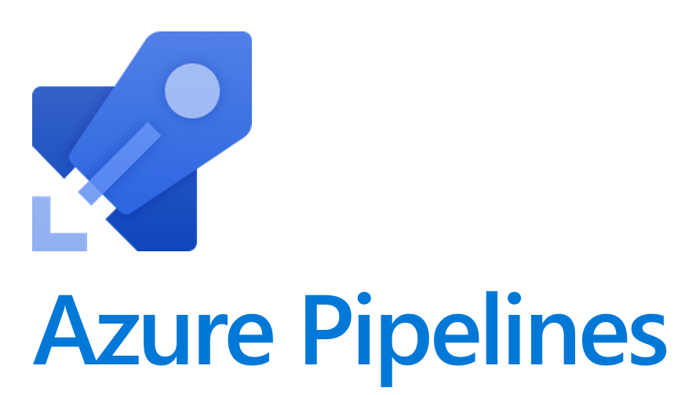
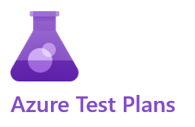

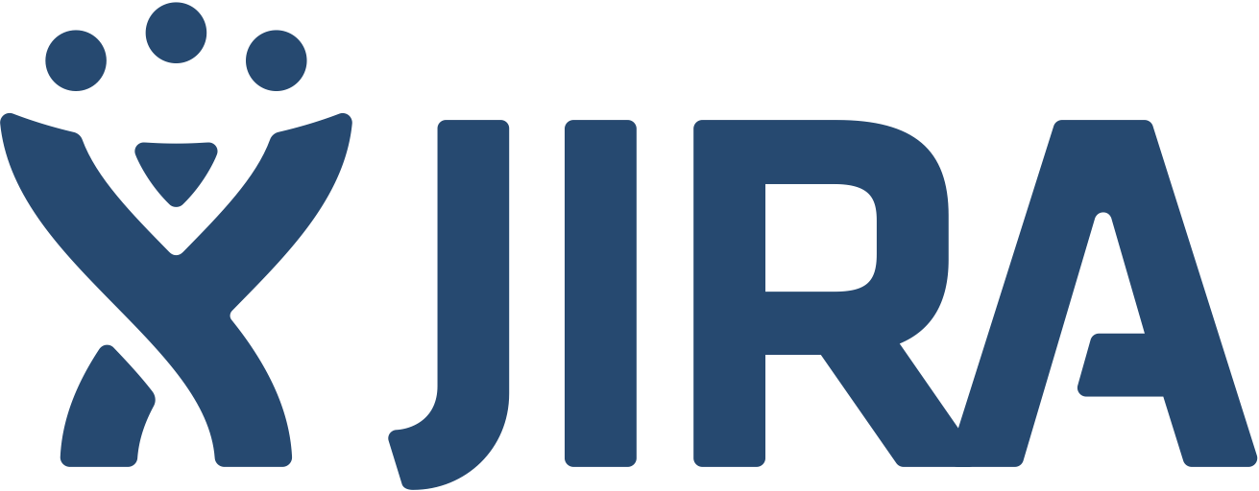

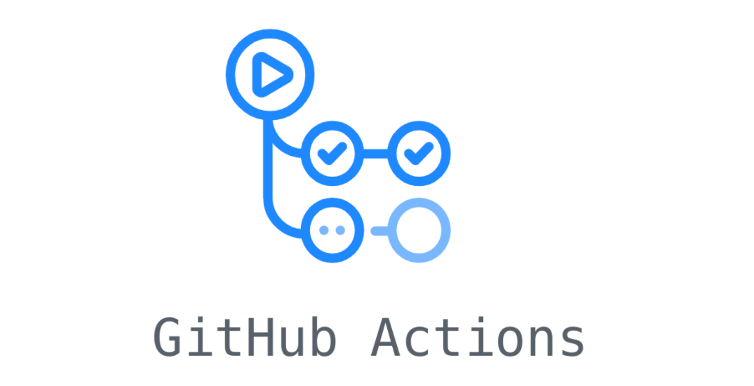

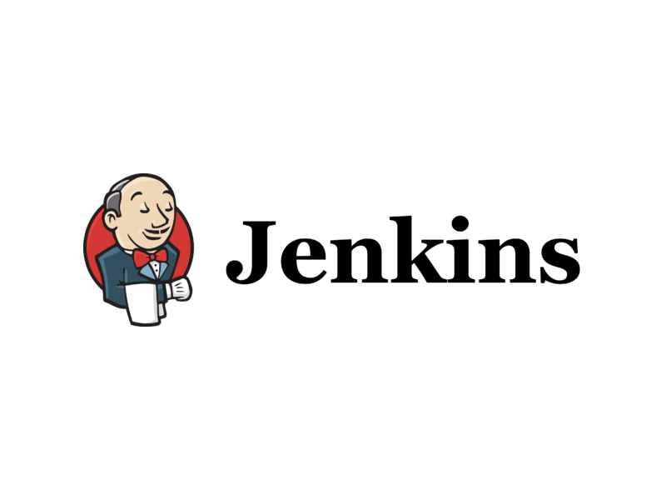


ALM Activities and Tools
Plan
Develop
Build & Release
Test
Operate
Backlog
Prioritisation
Planning
Build components
Source Control
Peer Reviews
Quality Checks
Packaging
Provisioning
Deployment CI/CD
Manual Testing
Automated Testing
UAT
Sign offs
Change Management
Logging & Monitoring
Incidents & Support Administration Feedback
Product Owner Team
Citizen Devs Pro Devs
Pro Devs
DevOps
Testers
Business
DevOps
Operations
Microsoft 365 Health

Slide 10
Environments
An Environment is a dedicated space in the Power Platform where you store, manage, and run apps, flows, agents and data. Each environment has its own Dataverse database, security boundary, and set of resources — completely isolated from other environments in your tenant.
Environment Types
Production
Live environment for end users. Full Dataverse capacity. Requires a paid licence. Intended for business-critical applications only.
How Environments Fit Into the ALM Pipeline
DEV
Development Environment — Developer type
Where makers build. Unmanaged solutions live here. Changes are exported by the pipeline and committed to source control. One per developer.
Sandbox
Non-production environment used for testing, QA, and UAT. Can be reset and copied. Ideal for Test and UAT stages in the ALM pipeline.
TEST
Test Environment — Sandbox type
Receives managed solution deployments from the pipeline. Used for automated testing and quality checks. No direct customisation.
Developer
Free personal environment for a single developer. Full Dataverse and premium connectors. Used as the DEV environment in this bootcamp.
UAT
UAT Environment — Sandbox type
Business sign-off environment. Stakeholders validate the solution before production release. Gated approval required to progress.
Trial
30-day temporary environment for evaluating Power Platform. Automatically expires. Not suitable for ALM pipelines.
PROD
Production Environment — Production type
Live environment for end users. Only receives managed solutions deployed by the approved pipeline. No direct edits permitted.
Default
Shared tenant environment created automatically. Cannot be deleted. Avoid using in ALM pipelines — no isolation or control.

Slide 11
Solutions
A Solution is a container that groups Power Platform components — apps, agents, flows, tables, and more — so they can be managed, versioned, and moved between environments as a single unit.
What’s Inside a Solution?
Canvas & Model-driven Apps
The apps your users interact with
Think of it as a way of organizing for your related Power Platform work in your development environment.
Dataverse Tables & Columns
Your data schema and structure
Cloud Flows & Automations
Power Automate workflows
Think of it as a shipping container for your Power Platform work — pack it up, move it, unpack it anywhere.
Copilot Studio Agents
AI Agents and Chatbots
Unmanaged · DEV only · editable
Managed · TEST / PROD · locked
Power Pages Sites
External-facing web portals
Connection References
Portable connector definitions
Solution flows through environments via the pipeline:
DEV
TEST
PROD
Environment Variables
Config values per environment

Slide 12
Managed vs Unmanaged Solutions
Unmanaged
Managed
Typical Environment
Development only
Test, UAT and Production
Customisation
Fully editable — components can be modified directly
Read-only — components are locked against direct edits
Source Control
Exported and committed to Git as unpacked source files
Built and packaged by the pipeline from source control
Deleting the Solution
Removes the container only — components remain in the environment
Removes the solution AND all its components from the environment
Version Numbering
Must be incremented manually before each export
Version is stamped and tracked by the pipeline on each deployment
Upgrades & Patches
Not applicable — changes are made directly in the environment
Supports full upgrade and patch deployment via the pipeline
Solution Layering
Active layer — customisations sit on top of any managed layers below
Base layer — provides a foundation that unmanaged layers can extend
Production Use
Not suitable for production — intended for development use only
Designed for production — the correct deployment target for live environments

Slide 13
Solution Import Types
Update
Upgrade
Replace the existing solution immediately in-place
Stage alongside old version, then cleanly replace
What it does
Overwrites the current version of the solution in the target environment immediately. Components present in the new version are added or updated. Components that are no longer in the solution are NOT removed from the environment.
Key behaviours
• Works whether or not a prior version exists
• Fastest import method
• Deleted components remain — manual cleanup required
• Can enable plug-in steps and flows on import
Use when
• First-time install into a new environment
• Iterating quickly in Test or DEV
• No components have been removed from the solution
• Speed is the priority over clean removal
What it does
Imports the new version alongside the existing solution as a staged upgrade (suffixed _Upgrade). On apply, the old solution and all removed components are deleted from the environment.
Use when
• Deploying to Production or UAT
• Components have been removed and must be deleted from the target
• A controlled, auditable deployment is required
Upgrade (immediate)
Stage for Upgrade
Stages and applies the upgrade in a single import action. Old solution and removed components are deleted automatically on completion.
Best for: standard Production and UAT deployments via the pipeline
Imports the new version but holds both solutions. You manually select Apply Solution Upgrade when ready.
Best for: data migration before cutover, or manual validation before applying
Quick Decision Guide
New environment, fast iteration, or no component removals?
→ Use Update
Production or UAT deployment, or components have been removed?
→ Always use Upgrade (recommended by Microsoft)

Slide 14
Solution Layers
Solutions exist at different layer levels within a Power Platform environment. The topmost layer always wins at runtime.
Working with Layers as a Developer
▲ RUNTIME ACTIVE (top layer wins) ▲
🔍 How to View Solution Layers
Active
Unmanaged Layer
All unmanaged solutions and direct customisations. Single layer. DEV environments only.
1. Go to make.powerapps.com and select Solutions
2. Open your solution and select a component (e.g. a table)
3. On the command bar select Advanced > See solution layers
4. All layers for that component are shown, newest at the top. The Active layer determines runtime behaviour
5. Select a layer to inspect its properties. Use Updated tab for changes only, or All Properties for everything
Last in
Managed Solution (most recently installed)
Can customise any solution installed below it. “Last one wins” for conflicts.
First in
Managed Solution (first installed)
Base managed layer. Restored if the layer above is uninstalled.
Base
System Layer
Platform tables and components. Cannot be removed. Always at the base.
🛠 Use Solution Layers for Troubleshooting
▼ BASE (system foundation) ▼
• Identify which solution introduced a specific change to a component
• Diagnose unexpected component behaviour caused by layering conflicts
• Resolve dependency issues during solution import failures
Key Behaviours
• Last one wins: when two managed solutions conflict, the most recently installed solution’s definition applies at runtime
• Merge logic: for some component types (e.g. forms, ribbons) Dataverse merges changes rather than replacing them
• Uninstall behaviour: removing a managed solution restores the layer below; removing all managed solutions falls back to the system layer
• Avoid component overlap: do not include the same component in more than one unmanaged solution
⚠ Removing an Unmanaged Layer
To remove: open the solution → select the component → See solution layers → select the unmanaged layer → Remove active customizations
• This action cannot be reversed — all data associated with the unmanaged customisation can be lost
• If the unmanaged layer is the only layer, you must delete the component itself instead

Slide 15
Power Platform CLI (PAC CLI)
PAC CLI is a cross-platform command-line tool for automating and scripting Power Platform administration, ALM, and development tasks. It is the foundation for the Azure DevOps Build Tools and GitHub Actions pipelines, and can also be used locally for day-to-day developer workflows.
Three Ways to Install
VS Code Extension
.NET Tool (Recommended)
Windows MSI
Search: Power Platform Tools in VS Code Extensions
Windows, macOS, Linux. PAC only available inside a VS Code terminal unless extra steps taken.
Best for: developers working primarily in VS Code
Command: dotnet tool install --global Microsoft.PowerApps.CLI.Tool
Windows, macOS, Linux. Available in any PowerShell, CMD, or Bash terminal. Does not include pac data or certain pac package commands.
Best for: pipelines, scripting, and cross-platform use
Download: powerapps-cli-1.0.msi from NuGet (Microsoft.PowerApps.CLI)
Windows only. Full feature set including pac data and pac package commands. Includes .NET Framework dependencies.
Best for: Windows-only workflows needing full feature parity
Key Command Groups
Authentication & Useful Commands
pac auth Create and manage authentication profiles for one or more tenants
pac solution Export, import, clone, pack, unpack, and check solutions
Authentication
pac env List, select, and manage Power Platform environments
pac admin Create, backup, copy, and manage environments at scale
Most commands require an active auth profile. Use:
pac auth create — connect to a tenant (browser sign-in)
pac auth list — show all saved profiles
pac auth select — switch between saved profiles
pac pcf Initialise, build, and version Power Apps Component Framework controls
pac data Import and export Dataverse reference data (Windows only)
pac package Deploy Package Deployer packages to environments
pac canvas Unpack, pack, and lint canvas app source files
Verify Installation & Get Help
pac — verify install and see version
pac help — list all command groups
pac solution --help — help for any command group
pac org who — confirm which environment you’re connected to

Slide 16
Git Integration with Power Platform
✗ Without Git
✓ With Git
Two Approaches to Git with Power Platform
✘ No history — impossible to see who changed what or when
✘ No rollback — a broken change can’t be easily undone
✘ Teams overwrite each other’s work with no conflict detection
✘ Manual exports — solutions zipped and emailed or shared via file storage
✘ No audit trail for compliance or governance
✘ Deployments are manual, error-prone, and undocumented
✘ No branching — parallel feature development is nearly impossible
✘ Disaster recovery depends on backups
✔ Full history — every change tracked with author, timestamp, and message
✔ Rollback — revert to any previous working state instantly
✔ Parallel development — branches isolate features without conflict
✔ Single source of truth — Git is the authoritative record of what’s deployed
✔ Audit trail — every commit is timestamped, attributable, and searchable
✔ Automated deployments — pipelines trigger on commits, removing manual steps
✔ Code reviews via pull requests before changes reach production
✔ Disaster recovery — the full solution can be rebuilt from source at any time
1 — Integrated Git (Native)
Built directly into the Power Platform Solutions experience. Makers commit and sync changes to an Azure DevOps Git repository from within Power Apps, Copilot Studio, Power Automate, or Power Pages — no command line required.
Best for: Citizen developers and makers who need version control without learning Git tooling
Requires: Managed Environments • Azure DevOps subscription • DEV environments only
2 — Pipelines + PAC CLI (Pro Code)
Azure DevOps pipelines use PAC CLI tasks to export solutions from DEV, unpack them into source files, commit to Git, then build managed solutions and deploy through TEST and PROD. Source control is the single source of truth.
Best for: Pro developers and teams needing full CI/CD, quality gates, and automated testing
Used in this bootcamp: This is the approach we will be implementing in today’s labs
Both approaches use Azure DevOps Git as the repository. They are complementary — Integrated Git handles the DEV commit workflow; pipelines handle the build and deployment workflow.

Slide 17
Build Process
Sources
Customizations
Build
Pack
Artifacts
Solutions
.NET Code (Plug-ins, CRM Packages)
Web Resources
Compile
Minify
Run Static Analysis
Run Unit Tests
Packages
Data
Tests
Custom Controls
Sign
Reference Data
Version

Slide 18
Release Process
Artifacts
Solutions
Release
Approvals
Environments
Test
SIT
UAT
OAT
Packages
Data
Tests
Backup/Rollback
Provision Environments
Import Solutions
Execute Packages
Import Data
Additional Steps
Execute Tests
Pre-Prod
Prod
Dev
PoC
Demo
Training
Notifications

Slide 19

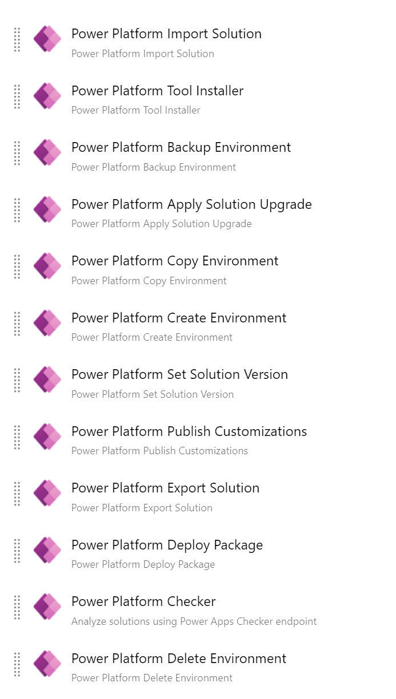
Power Platform Build Tools
Preview Released in July 2019 and Initial Release in June 2020
Supports Dynamics CE/PowerApps
Published by Microsoft
Over 25 Azure DevOps Tasks for
Solution Import/Export/Apply
Solution Pack/Unpack
Package Deployer
Solution Checker
Utilities (Version/Publish)
Environments Management
Power Apps Pages/Data
Notes:
https://marketplace.visualstudio.com/items?itemName=microsoft-IsvExpTools.PowerPlatform-BuildTools

Slide 20
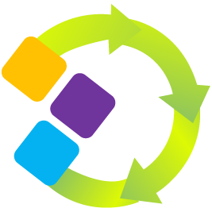
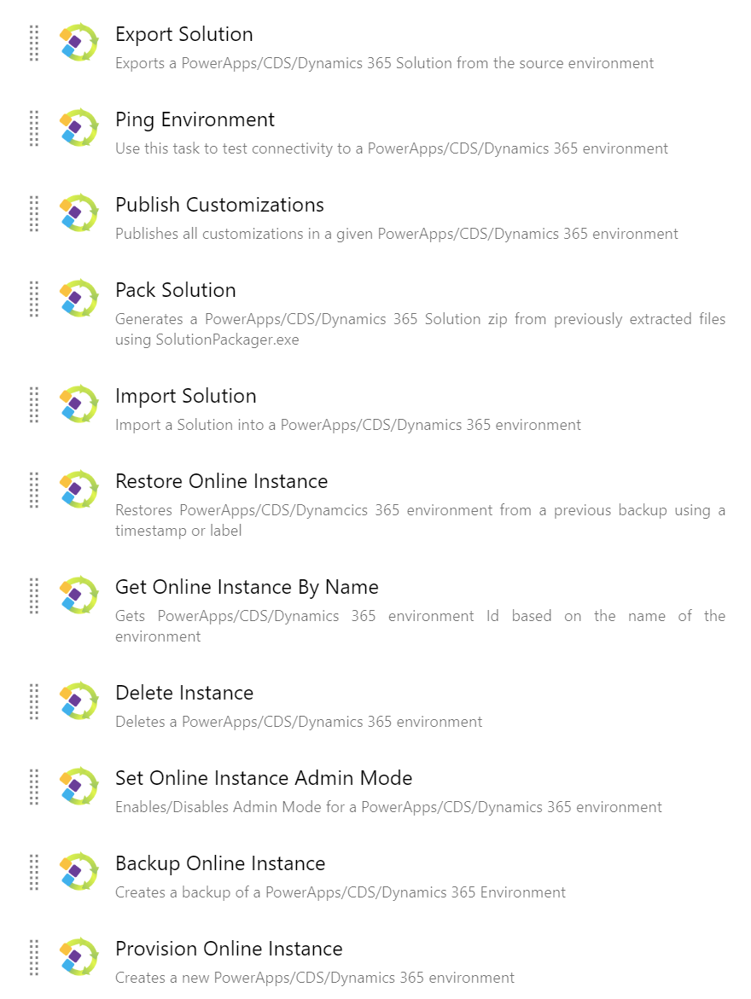
Power DevOps Tools
Released in Jan 2017
Supports 9.x/8.2* (Online/On-premises*)
Free Open Source on GitHub
Over 50 Azure DevOps Tasks for:
Solution Import/Export/Upgrade
Solution Pack/Unpack (Mapping File)
Package Deployer
Solution Checker (Quality Gate)
Environments Management (Get/Admin Mode)
Utilities (Version/Publish/Plug-ins/Web Resources)
Solutions (CRUD/Copy/Clone/Patch/Validate)
Reference Data (CMT) / Configuration Data
Environment Variables/Service Endpoints

Slide 21
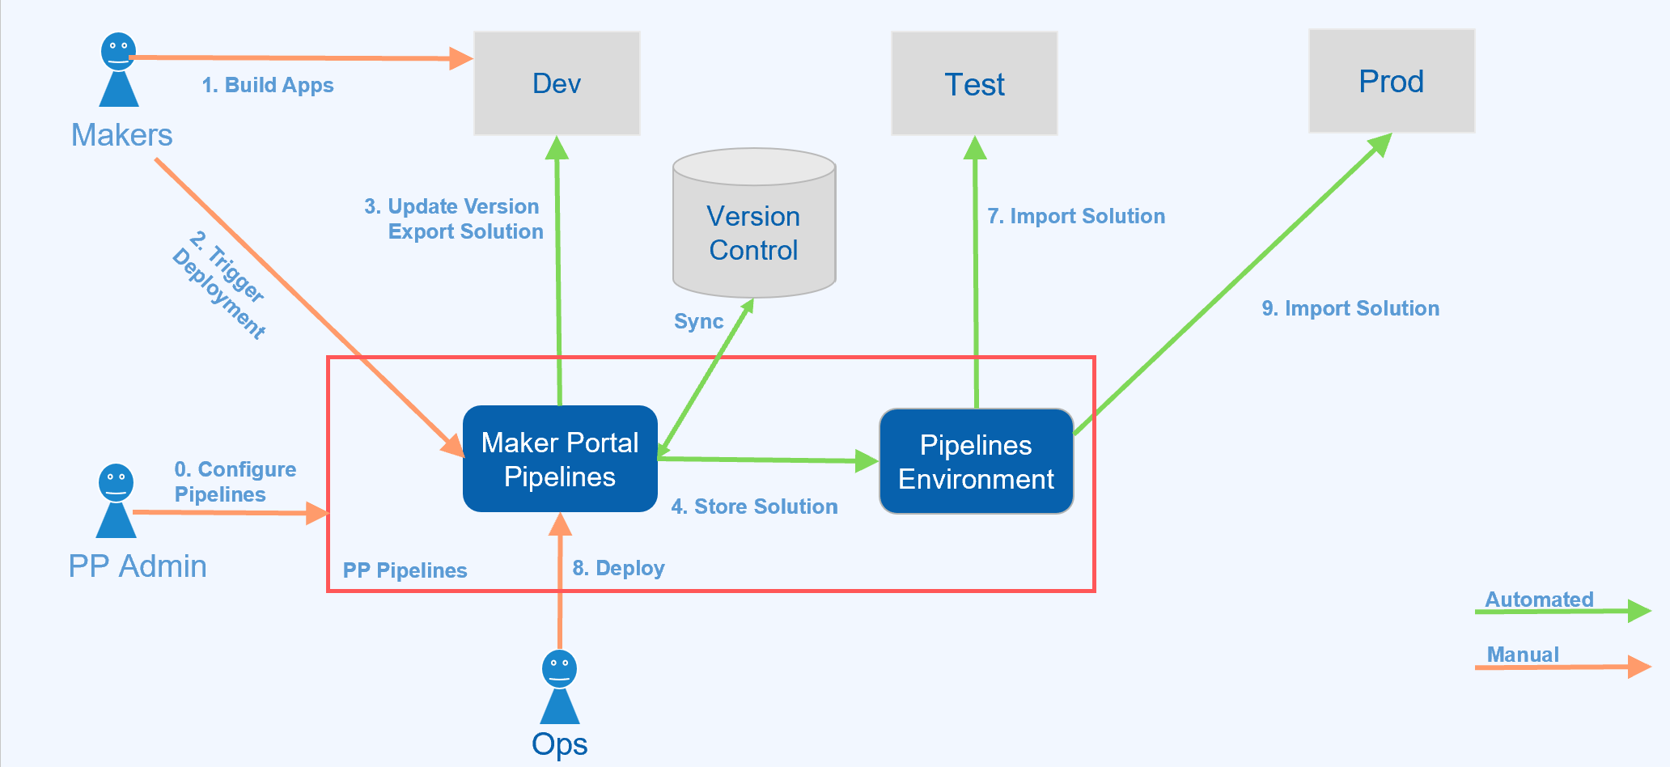
PP Pipelines

Slide 22

Current State of Power Platform DevOps

